Slide 1
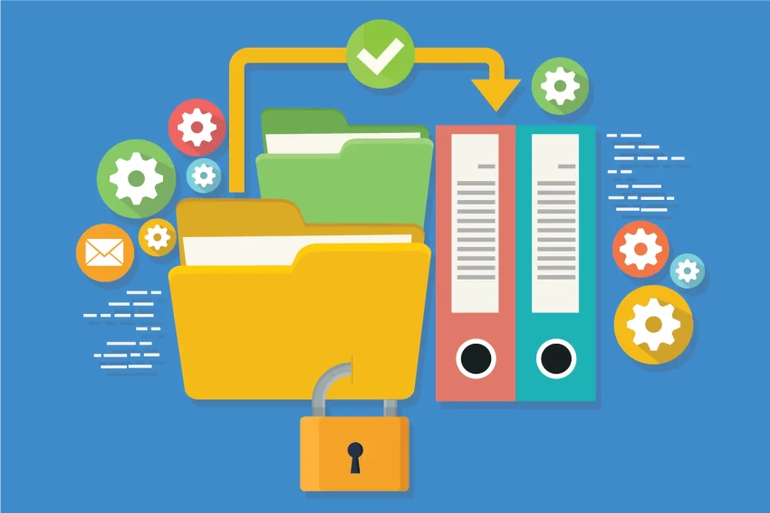
SafeLAN: Adaptive Secure File System for LAN environment
25-26J-067

Slide 2
Introduction
SafeLAN is a secure file system that will utilize advanced mechanisms such as keystroke dynamics, mouse movements, blockchain technology to improve the current security state of file systems.

Slide 3
Research problem
Existing LAN-based file systems rely on traditional authentication methods or OS-level permissions, which provide only one-time authentication. They lack integrated mechanisms for real-time anomaly detection.
They lack continuous and dynamic identity verification, leaving systems vulnerable to insider threats, hijacking, and misuse after login.
File access logs are often local, alterable, and non-transparent, making post-incident investigations difficult.
Many advanced security features today are internet or cloud-dependent. As a result, LAN only environments are left with weaker protections.

Slide 4
Research Objectives
To build a secure desktop-based file management system for Local Area Network environments.

Slide 5
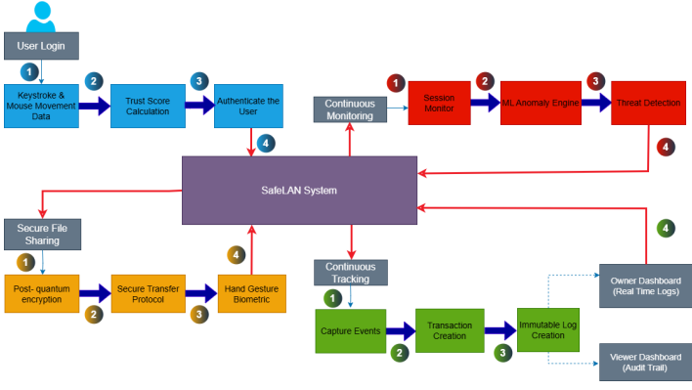
System Diagram

Slide 6

BEHAVIOURAL BIOMETRICS-BASED ADAPTIVE AUTHENTICATION MODULE FOR safELAN
BSC (HONS) DEGREE IN INFORMATION TECHNOLOGY (SPECIALIZATION IN
CYBER SECURITY)
IT22328298 | Waidyarathne U H A P G | 25-26J-067

Slide 7
Behavioural Biometrics-Based Adaptive Authentication Module for SafeLAN
Problem: Current LAN file systems rely only on static password logins.
Solution: Module verifies users via keystroke dynamics of credentials at login, creating a behavioural signature with the use of a trust score to strengthen the system access security.
Benefits: Reduces unauthorized access risk, mitigates insider threats, and strengthens security at the entry point of the LAN system.
❌ Current Shortcomings
Only checked once at login.
Anyone with stolen credentials can enter.
No behavioural analysis.
Vulnerable to credential theft
✅ Our Solutions
Verifies typing style of entered credentials.
Grants access only if typing matches user’s behaviour.
Stops unauthorized logins even with stolen passwords.
IT22328298 | Waidyarathne U H A P G | 25-26J-067

Slide 8






Behavioural Biometrics-Based Adaptive Authentication Module for SafeLAN
Key Domains
Authentication
Machine Learning
Technologies Used
CNN (Conventional Neural Networks)
LSTM (Long and Short Term Memory)
Public Datasets
Data & Ethics
User consent required for SafeLAN registration typing profiles
IT22328298 | Waidyarathne U H A P G | 25-26J-067

Slide 9
Behavioural Biometrics-Based Adaptive Authentication Module for SafeLAN
Validating Accuracy of the Authentication Module
Train-Test Split: Use part of the dataset for training, part for testing.
Cross-Validation: Cross-validation to ensure robustness across users.
Metrics
Accuracy
False Acceptance Rate (FAR)
False Rejection Rate (FRR)
Trust Score Threshold Testing: Evaluate performance for different trust score cut-offs.
Simulated Attack Testing: Test against impersonation attempts or anomalous typing patterns.
IT22328298 | Waidyarathne U H A P G | 25-26J-067

Slide 10
Behavioural Biometrics-Based Adaptive Authentication Module for SafeLAN
System Overview
Runs at login only, analyzing keystroke dynamics.
CNN + LSTM model for spatial and temporal typing patterns.
Computes a trust score for user authenticity.
Grants, restricts, or denies access based on trust score.
Real World Usage
User enters username & password.
Typing pattern captured during login.
Trust score calculated in real-time.
High → login successful
Low → login blocked/ re- authentication
IT22328298 | Waidyarathne U H A P G | 25-26J-067

Slide 11

Behavior Anomaly Detection using Machine Learning to Ensure Continuous Authentication
BSC (HONS) DEGREE IN INFORMATION TECHNOLOGY (SPECIALIZATION IN
CYBER SECURITY)
IT22029386 | Wahalathanthri C D | 25-26J-067

Slide 12
Behavior Anomaly Detection using Machine Learning to Ensure Continuous Authentication
Knowledge Gap / Problem Definition
Traditional authentication in LANs only verifies at login.
Post-login hijacking (physical & remote) remains a major risk.
Shortcomings of Existing Systems
No continuous verification after login.
Limited real-world LAN-focused solutions.
Proposed Solution
SafeLAN: ML-driven behavioral anomaly detection for continuous authentication.
Uses keystroke, mouse, and system usage patterns.
IT22029386 | Wahalathanthri C D | 25-26J-067

Slide 13


Technologies and Tools
Latest Technologies
ML models: Random Forest, One-Class SVM
Frameworks: TensorFlow, PyTorch, Scikit-learn.
IT22029386 | Wahalathanthri C D | 25-26J-067

Slide 14
Behavior Anomaly Detection using Machine Learning to Ensure Continuous Authentication
Data Availability & Ethics
Behavioral logs: keystrokes, mouse dynamics, file access.
Ethical clearance: anonymized, non-intrusive data collection

Slide 15
Behavior Anomaly Detection using Machine Learning to Ensure Continuous Authentication
System Overview
User login → Behavior monitoring → Feature extraction → ML anomaly detection → Decision response (MFA/lockout).
Real-world Use
Continuous verification during LAN sessions.
Automatic alerts & mitigation on anomalies.
Protects sensitive data in enterprises, government, healthcare.
IT22029386 | Wahalathanthri C D | 25-26J-067

Slide 16

Secure file viewing with a new biometric to lockdown browser
BSC (HONS) DEGREE IN INFORMATION TECHNOLOGY (SPECIALIZATION IN
CYBER SECURITY)
IT22323002 | Hirimuthugoda N A| 25-26J-067

Slide 17
Secure file viewing with a new biometric to lockdown browser
Spoofing Attacks – Fake biometric samples to impersonate.
Privacy issues when storing biometric data.
Data Corruption compromising integrity.
Deepfakes.
Phishing Attacks.
No Data Storage.
No verification links involved.
Brute-Forcing codes impossible.
IT22323002 | Hirimuthugoda N A| 25-26J-067

Slide 18
Secure file viewing with a new biometric to lockdown browser
User Receives Code → User Performs Hand Gesture → Gesture Captured via Webcam one by one → Gesture Recognition Engine → Code Match Verification → Access Granted in Lockdown Browser
IT22323002 | Hirimuthugoda N A| 25-26J-067

Slide 19
Secure file viewing with a new biometric to lockdown browser
Ways to validate accuracy include:
Test for valid and invalid gesture input.
Test for gesture performance under different light conditions.
Test for gesture performance under different angles.
IT22323002 | Hirimuthugoda N A| 25-26J-067

Slide 20
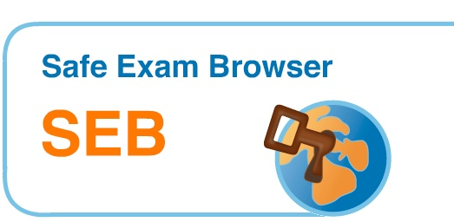

Secure file viewing with a new biometric to lockdown browser
MediaPipe is better for in recognizing hand gestures with inbuilt datasets.
SEB is an open-source software.
IT22323002 | Hirimuthugoda N A| 25-26J-067

Slide 21


Blockchain-Based Dual-Logging System For LAN
BSC (HONS) DEGREE IN INFORMATION TECHNOLOGY (SPECIALIZATION IN ​
CYBER SECURITY​)
IT22892744 | Dias W P S | 25 – 26J - 067

Slide 22
Blockchain-Based Dual-Logging System For LAN
Challenges
Centralized Architecture: Single point of failure and control
Vulnerability to Tampering: Logs can be modified or deleted by malicious actors
Insider Threats: System administrators can manipulate audit trails
Limited Integrity Assurance: No cryptographic proof of log authenticity
❌ Current Shortcomings
Centralized control vulnerabilities
Log tampering possibilities
Insider threat exploitation
Internet-dependent blockchain solutions
High resource consumption
✅ Our Solutions
Distributed validation nodes
Cryptographic hash chains
Multi-node consensus mechanism
LAN-optimized lightweight protocol
Efficient Proof-of-Authority consensus
IT22892744 | Dias W P S | 25 – 26J - 067

Slide 23
Blockchain-Based Dual-Logging System For LAN
Key Domains of Cyber Security Knowledge
Cryptography: Hash functions, Digital signatures, Merkle trees, Key management
Network Security: LAN security protocols, Intrusion detection, Secure communications
Digital Forensics: Evidence preservation, Chain of custody, Log analysis, Incident response
Distributed Systems: Consensus algorithms, Fault tolerance
Technologies Utilized
Blockchain Technology - immutable logging
Proof-of-Authority Consensus - energy efficiency
SHA-256 Cryptographic Hashing
Digital Timestamps
Merkle Tree Structure for efficient verification
IT22892744 | Dias W P S | 25 – 26J - 067

Slide 24
Blockchain-Based Dual-Logging System For LAN
Success Evaluation & Validation Methods :
Performance Metrics
Security Validation
Legal Compliance
Data Availability & Ethical Clearance
Data Sources: Synthetic logs, University lab data
Ethics: IRB approval, No personal data
Compliance: GDPR protocols, Anonymized metadata
IT22892744 | Dias W P S | 25 – 26J - 067

Slide 25
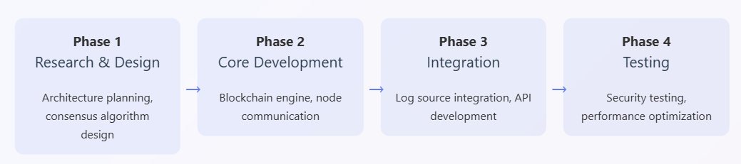
Blockchain-Based Dual-Logging System For LAN
Real world Usage
User shares a confidential financial file with receiver.
Blockchain records tamper-proof log entry (time, file hash, IDs).
Both the user & receiver verify the log independently in real-time.
IT22892744 | Dias W P S | 25 – 26J - 067

Slide 26
Ability of Co“SafeLAN”: Adaptive Secure File System for LAN environmentmmercialization
Target Marketplace : Small to Medium scaled organizations.

Slide 27

THANK YOU

